Slide 1



Module 3: Cloud Infrastructure and Platforms in Industry

Slide 2
Outline
Why Data Center
Data Center- Servers
Basic DCN Architecture (3 tier)
Issues with traditional 3 tier architecture
What is WSD (Warehouse-Scale Data-Center)
Leaf Spine Architecture
Topologies in WSD
i. Fat-Tree topology
ii. BCube network

Slide 3
Why Data Center ?
Large amount of data and information is being transmitted worldwide- question of storing the data.
One approach is to store data on the Server and the other option is to store on Data Center.
The drawback of storing data on server is need for server rooms increases as the demand for storage increases.
Server rooms produce tremendous amount of heat and which in turn have to be kept cool. Cooling factor leads to increase in cost.
Servers have to be maintained 24 X 7 by an individual.
Keeping critical data in house is like keeping money wide open for robbers to steal- financial and mental stress.

Slide 4
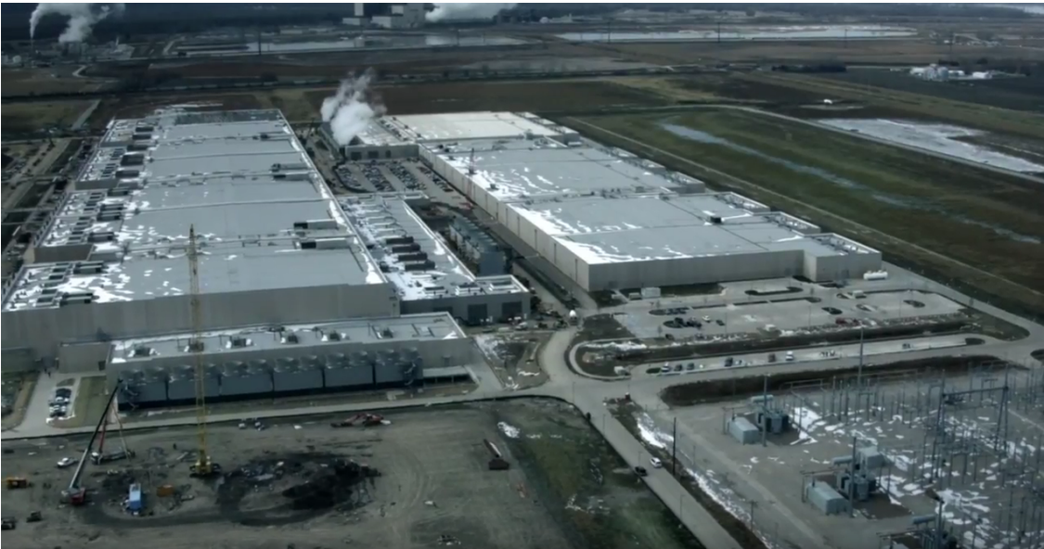
Data Center Pictures

Slide 5
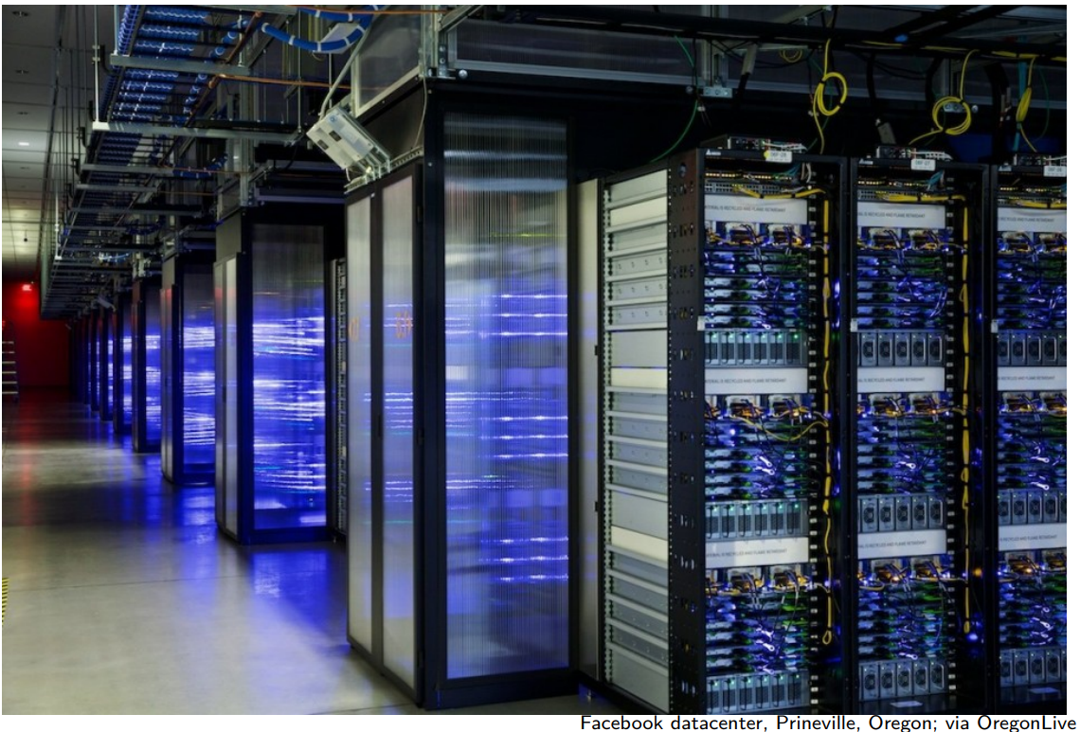
Data Center Pictures- Sever Racks

Slide 6
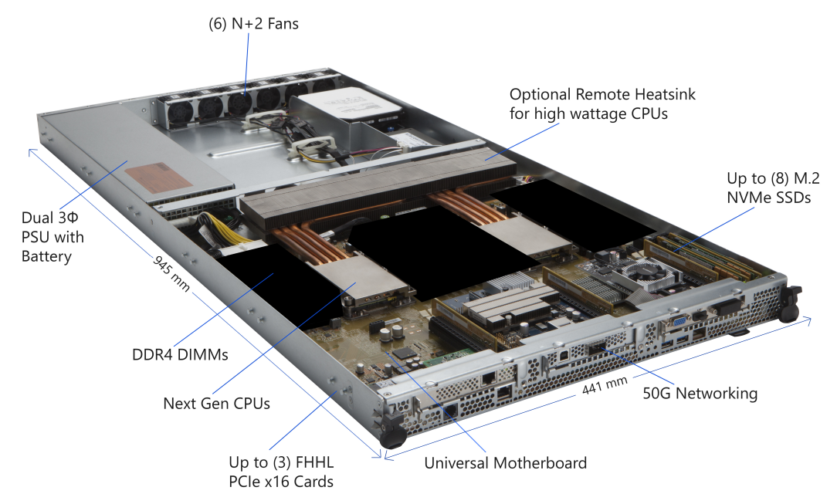
2. Data Center Pictures- Servers

Slide 7
Data Center Pictures- Servers
N+2 Fans - Cooling + Reliability: Fans push air through the server to remove heat from CPU, RAM, SSDs, etc.
“Remote heatsink” - Modern CPUs can be very high power (high TDP- Thermal Design Power). Heat is moved away (often using heat pipes) to a location with stronger airflow. Helps cool hotter CPUs in a tight 1U (1.7f inches height) chassis.
Dual 3Φ (Three-Phase) PSU (Power Supply Unit) with Battery -
Dual PSU: Two power supply units → redundancy (if one fails, other can keep server alive). In racks, typically each PSU is connected to a different power feed.

Slide 8
Data Center Pictures- Servers
3. 3Φ (Three-phase power)
Used in data centers for efficiency and to handle high power loads better than single phase.
4. DDR4 DIMMs — Main Memory (RAM)
5. Next Gen CPUs — Compute engines (running OS / hypervisor (VMware, KVM, Hyper-V), running workloads: web apps, databases, AI inference, etc.)
6. (8) M.2 NVMe SSDs — High-speed storage
7. 50G Networking — High bandwidth connectivity
8. Up to (3) FHHL PCIe x16 Cards — Expansion / Acceleration- Full Height Half Length (Supports GPUs, SmartNIC)
9. Universal Motherboard — “Main highway” connecting everything

Slide 9
Data Center Pictures- Servers
How everything works together (simple flow)
Power path
AC power → Dual PSU → motherboard power rails → CPU/RAM/SSD/NIC
Data path
CPU ↔ RAM (fastest) CPU ↔ NVMe SSD (very fast storage) CPU ↔ NIC (network traffic out to other servers/storage) CPU ↔ PCIe cards (GPU/NIC/etc.)
Cooling path
Fans pull/push air → across heatsinks + components → exhaust out the back

Slide 10
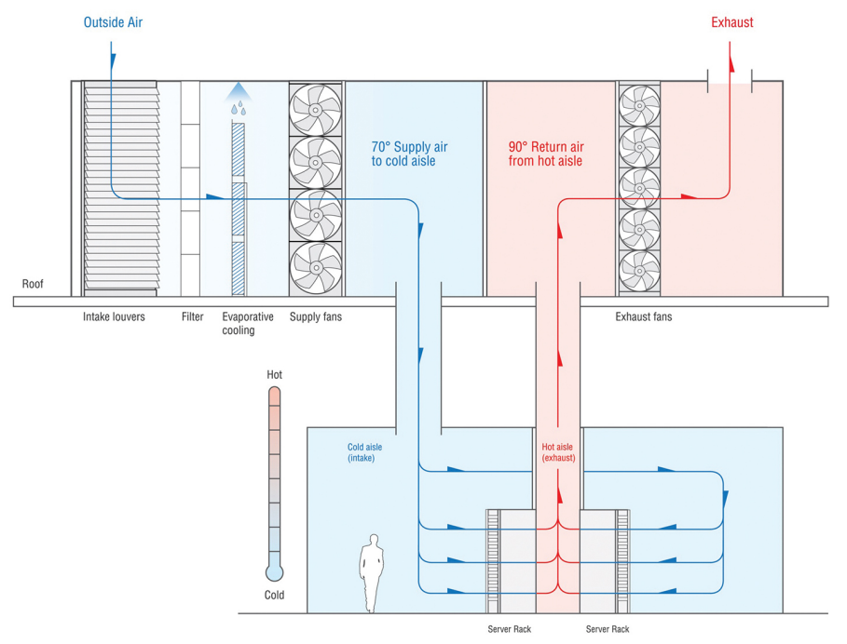
Data Center Pictures- Cooling
Sasser, “A Look at Data Center Cooling Technologies”

Slide 11
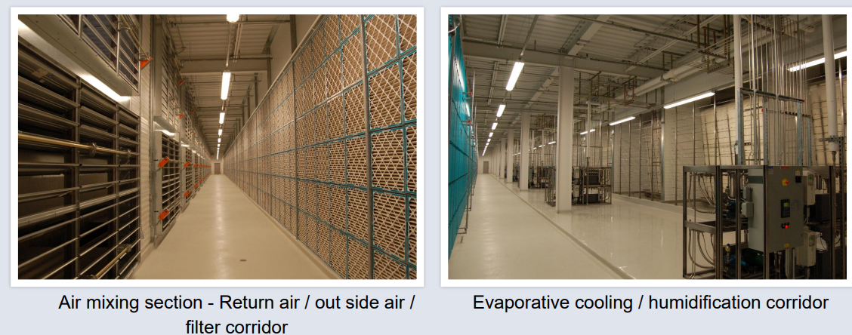
Data Center Pictures- Mechanical Penthouse
Sasser, “A Look at Data Center Cooling Technologies”

Slide 12
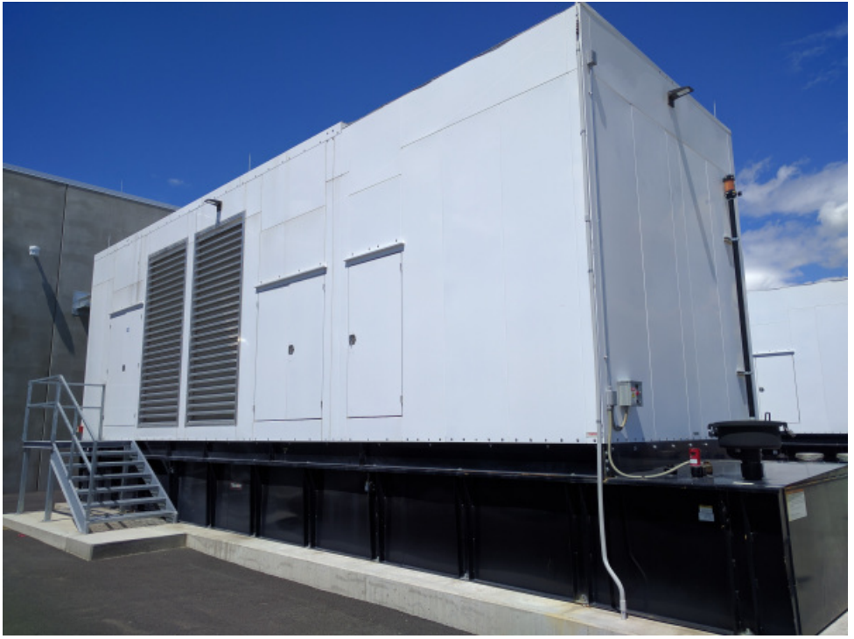
Data Center Pictures- Backup Power
Facebook datacenter, Prineville, Oregon; via TechCrunch

Slide 13
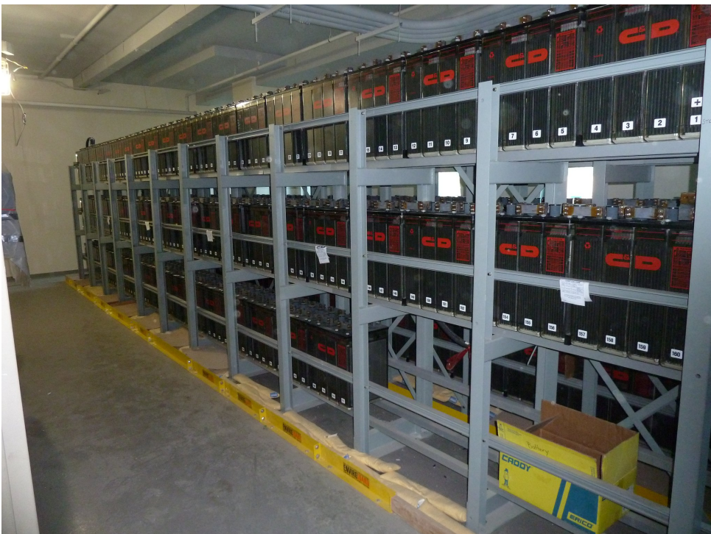
Data Center Pictures- Battery Room
NOAA Center for Weather and Climate Prediction (at University of Maryland)

Slide 14
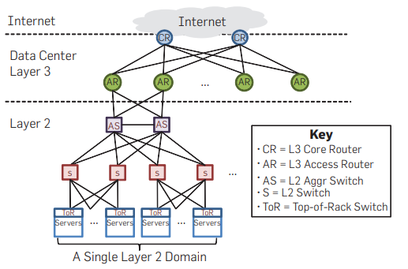
3. Basic DCN (Data Center Network) Architecture- traditional 3-tier data-center network with a shared Layer-2 domain
Data sent as IP packets using IP addresses
Data sent as Ethernet Frames using MAC addresses
Layer 1 is present everywhere in the network diagram as the physical connections between devices.
Notes:
CR - like which data center
AR- INside data center, which block or cluster the request should go to
AS and L2 switch, they will check source and destination MAC address
ToR swith- at top of every server

Slide 15
Basic Networking
Identity | Meaning | Example | Used By
IP address | Logical address (who you are) | 192.168.1.10 | applications Layer 3 (Network layer)
MAC address | Physical address (where you are plugged) | AA:BB:CC:11:22:33 | Ethernet Layer 2 (Data Link Layer)
Address Resolution Protocol (ARP)
finds the MAC address corresponding to an IP address

Slide 16
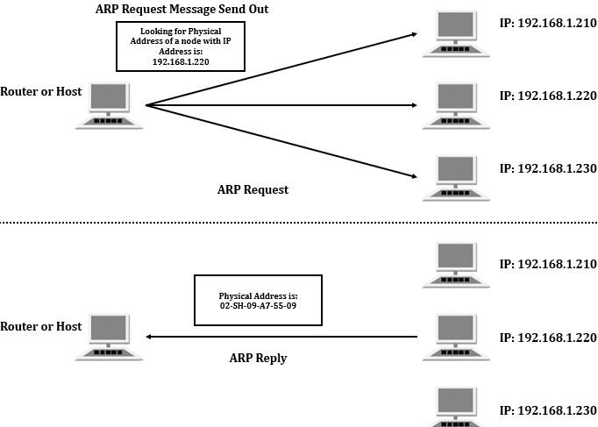
Basic Networking

Slide 17
Basic Networking
ARP Table
IP MAC
192.168.1.20 → BB:BB:BB:BB:BB:BB
Switches maintain MAC table
MAC Port
AA:AA:AA:AA:AA:AA → Port 3
BB:BB:BB:BB:BB:BB → Port 7

Slide 18
Basic Networking
The laptop sends a DNS query containing the domain name www.google.com to a DNS server, which resolves the name and returns the corresponding IP address (for example, 134.100.78.9).
Now the laptop checks its routing table to find IP address of default gateway. After that laptop checks local ARP table to find associated MAC address. If found, packet sent to default router. If not found, ARP broadcast message is sent to whole network asking for corresp. MAC address.
This default router will send packet to next hop (router) using its Routing table and ARP table for IP address and MAC address of next hop.

Slide 19
Basic Networking
One hop forwards the packet to the next hop, and this process continues until the packet reaches the last router connected to the destination local network. At this point, the router resolves the MAC address of the Google server using ARP and forwards the packet to the server.
Packet is forwarded to a switch after resolving the server’s MAC address using ARP. The switch then uses its MAC address table to map the destination MAC address to the appropriate port and delivers the frame to the destination machine.

Slide 20
Basic DCN (Data Center Network) Architecture- traditional 3-tier data-center network with a shared Layer-2 domain
Data sent as IP packets using IP address of server
Data sent as Ethernet Frames using MAC address of server
Layer 1 is present everywhere in the network diagram as the physical connections between devices.
Notes:
CR - like which data center
AR- INside data center, which block or cluster the request should go to
AS and L2 switch, they will check source and destination MAC address
ToR swith- at top of every server

Slide 21
Basic DCN (Data Center Network) Architecture
Top Layer : Internet + CR (Core Routers) — Layer 3
Internet
Represents the external world (users, other data centers, WAN).
CR = L3 Core Routers
Highest level routers in the data center.
Responsibilities:
Connect the data center to the Internet/WAN
Perform Layer-3 routing (IP routing)

Slide 22
Basic DCN (Data Center Network) Architecture
2. Data Center Layer 3: AR (Access Routers)
AR = L3 Access Routers
Sits between core routers and aggregation switches
Functions:
Routes traffic inside the data center
Apply policies (ACLs, routing decisions)
Act as a boundary between L3 and L2 parts
At this point, traffic transitions from pure routing to switching.

Slide 23
Basic DCN (Data Center Network) Architecture
3. Layer 2: AS (Aggregation Switches)
AS = L2 Aggregation Switch
Aggregate multiple lower-level switches
Key role:
Collect traffic from many access switches
Reduce number of connections going upward
Operates at Layer 2 (Ethernet)
This is where oversubscription often begins - It is the rate when all the devices are sending data (traffic) at the same time. It can be measured in the traffic entering or leaving the data center and in traffic between the devices in the data center. It is the ratio between the bandwidth of backbone switches and to the capacity of servers.

Slide 24
Basic DCN (Data Center Network) Architecture
4. Layer 2: S (Access / Edge Switches)
S = L2 Switch
Connects directly to Top-of-Rack (ToR) switches
Acts as an edge switch for server racks
Still Layer 2 → MAC-based forwarding
5. Bottom: ToR + Servers
ToR = Top-of-Rack Switch
One ToR per rack
Directly connects to Physical servers
Advantages: Short cables, Easier rack management

Slide 25
Basic DCN (Data Center Network) Architecture
6. Servers
Run applications, VMs, databases, etc.
7. A Single Layer-2 Domain
This is the most critical concept in the diagram. All servers share: same broadcast domain, Same VLAN space, Protocols like- ARP, Broadcast traffic

Slide 26
Knowledge Check
Which of the following devices uses MAC addresses for forwarding frames?
A. Router
B. Switch
C. Gateway
D. Firewall
2. Which device operates primarily at the Network Layer?
A. Switch
B. Router
C. Bridge
D. Hub
3. Which device primarily uses the destination IP address to forward packets?
A. Hub
B. Switch
C. Router
D. Repeater
4. The primary function of ARP is to:
A. Map MAC address to port number
B. Map IP address to MAC address
C. Map IP address to DNS name
D. Map MAC address to IP subnet
Notes:
B
B
C
B

Slide 27
Knowledge Check
Q5. When is an ARP request broadcast?
A. When destination IP is unknown
B. When MAC address for next-hop IP is unknown
C. When packet size exceeds MTU
D. When router table is full
Q6. Which statement about ARP is TRUE?
A. ARP works at application layer
B. ARP uses TCP
C. ARP request is broadcast, reply is unicast
D. ARP assigns IP addresses
Q7. Which layer in a 3-tier DCN directly connects to servers?
A. Core
B. Aggregation
C. Access
D. Distribution
Q8. The primary role of the Access Router is to:
A. Connect servers
B. Provide high-speed switching between aggregation switches
C. Perform ARP resolution
D. Handle storage traffic
Notes:
5. B
6. C
7. C
8. B

Slide 28
Knowledge Check
Q10. VM migration in a 3-tier DCN is difficult mainly because:
A. MAC addresses cannot move
B. IP addressing and Layer-2 boundaries are tightly coupled
C. Routers do not support ARP
D. Switches cannot learn MAC addresses
Q11. Why is a traditional 3-tier DCN less suitable for cloud data centers?
A. It does not support IP addressing
B. It cannot support virtualization
C. It is optimized for client-server traffic, not VM-to-VM traffic
D. It does not use switches
Notes:
10. B
11. C

Slide 29
4. Issues with traditional DCN Architecture
Scalability Limitations
Large single Layer-2 domain does not scale beyond a few thousand servers
MAC tables, ARP tables, and control traffic grow exponentially
Adding more racks increases complexity, not capacity
Scaling is done by- adding bigger switches, Increasing port density, Core and aggregation switches become choke points
Broadcast Storms & Control Overhead
ARP, DHCP, and unknown unicast frames are broadcast to all servers.
Broadcast traffic consumes bandwidth and CPU on every device
One faulty device can flood the entire data center

Slide 30
Issues with traditional DCN Architecture
3. Oversubscription & Bandwidth Bottlenecks
In 3-tier DCN, North–South traffic assumed dominant and Uplinks are fewer than downlinks but modern cloud apps generate East–West traffic i.e. VM ↔ VM and Microservices ↔ Microservices
Congestion occurs at aggregation/core
Latency increases
Failure impact increases (incase aggregation switch fails)
4. The traditional 3-tier DCN was designed for enterprise client–server traffic, supports more of vertical scaling instead of horizontal

Slide 31
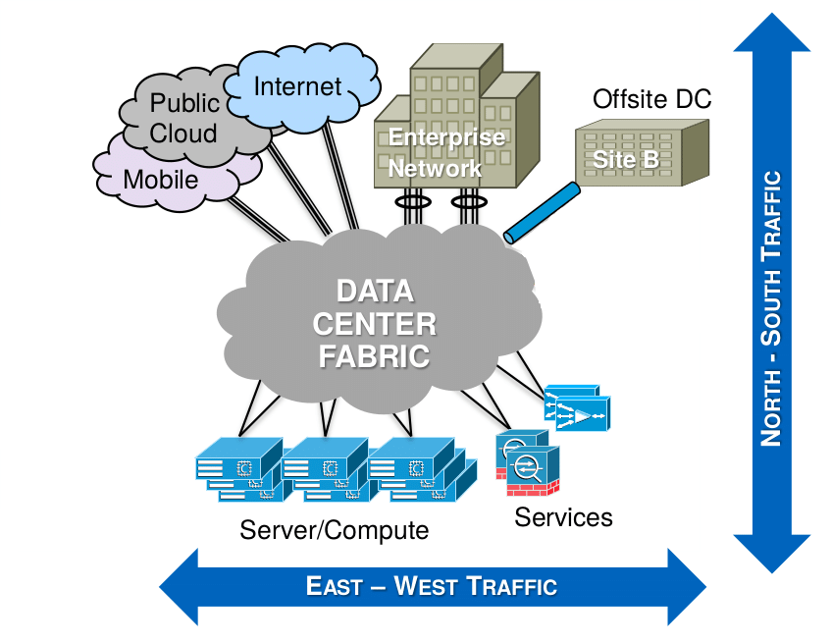
Issues with traditional DCN Architecture

Slide 32
5. What is Warehouse Scale Computer (WSC) or Warehouse Scale Datacenter (WSD)
A Warehouse-Scale Data Center (WSD) is a large-scale computing facility designed to host tens or hundreds of thousands of servers. It is operated by a single organization (e.g., Google, Amazon, Microsoft) and is treated as one large computer, not as independent servers.

Slide 33
5. What is Warehouse Scale Computer (WSC) or Warehouse Scale Datacenter (WSD)
Trends toward server-side computing and widespread internet services created a new class of computing systems that were named warehouse-scale computers,or WSCs.
This perspective is a departure from a view of the computing problem that implicitly assumes a model where one program runs in a single machine.
In warehouse-scale computing, the program is an internet service, which may consist of tens or more individual programs that interact to implement complex end-user services such as email, search, or maps.
These programs might be implemented and maintained by different teams of engineers, perhaps even across organizational, geographic, and company boundaries

Slide 34
What is Warehouse Scale Computer (WSC) or Warehouse Scale Datacenter (WSD)
The hardware for such a platform consists of thousands of individual computing nodes with their corresponding networking and storage subsystems, power distribution and conditioning equipment, and extensive cooling systems. The enclosure for these systems is in fact a building, which is often indistinguishable from a large warehouse.
Data centers are buildings where multiple servers and communication gear are co-located because of their common environmental requirements and physical security needs, and for ease of maintenance.

Slide 35
What is Warehouse Scale Computer (WSC) or Warehouse Scale Datacenter (WSD)
Aspect | Traditional Data Center | Warehouse-Scale Data Center (WSC)
Ownership & Control | Hosts infrastructure for multiple organizational units or companies | Owned and operated by a single organization
Application Type | Large number of small / medium applications | Small number of very large applications (internet services)
Hardware Usage | Each application runs on dedicated hardware | Hardware is shared and pooled across applications
Hardware Homogeneity | Heterogeneous hardware (different vendors, generations) | Highly homogeneous hardware platform
System Software | Mix of operating systems and third-party software | Uniform system software, largely built in-house
Notes:
Large applications- gmail, facebook (duistribuyted networks, high bandwidth, composed of manyicroservices that may be hosted on multiple different servers)
Small applications- HR system, payroll system,

Slide 36
What is Warehouse Scale Computer (WSC) or Warehouse Scale Datacenter (WSD)
Aspect | Traditional Data Center | Warehouse-Scale Data Center (WSC)
Application Communication | Applications rarely communicate with each other | Components constantly communicate (east–west traffic)
Management Model | Separate management per system or department | Common centralized systems management layer
Scalability Approach | Vertical scaling (bigger servers, bigger switches) | Horizontal scaling (add more servers)
Network Traffic Pattern | Dominantly north–south | Dominantly east–west
Failure Assumption | Failures are rare and avoided | Failures are expected and tolerated

Slide 37
What is Warehouse Scale Computer (WSC) or Warehouse Scale Datacenter (WSD)
Aspect | Traditional Data Center | Warehouse-Scale Data Center (WSC)
Fault Tolerance Strategy | Hardware redundancy, expensive components | Software-based fault tolerance
Availability Model | Depends on reliable hardware | Designed for ≥ 99.99% availability despite failures
Deployment Flexibility | Limited; rigid allocation | Highly flexible deployment via resource pooling
Example Users | Enterprises, banks, universities | Google, Amazon, Microsoft, Meta, Alibaba

Slide 38
6. Modular Data Center
Traditional Data Center is
Built on-site, from the ground up, with structural, electrical, and mechanical work done at location.
Designed as a permanent facility with capacity often built upfront.
Works well for predictable growth and long-term planning.
Construction and commissioning can take 12–24+ months or more.

Slide 39
6. Modular Data Center
Modular Data Center is:
Made of prefabricated modules that are built in a factory environment.
Modules include structure, power, cooling, and security elements integrated and tested before shipping.
Delivered to site and assembled with minimal on-site construction.
Allows capacity to be added in phases, rather than all at once.

Slide 40
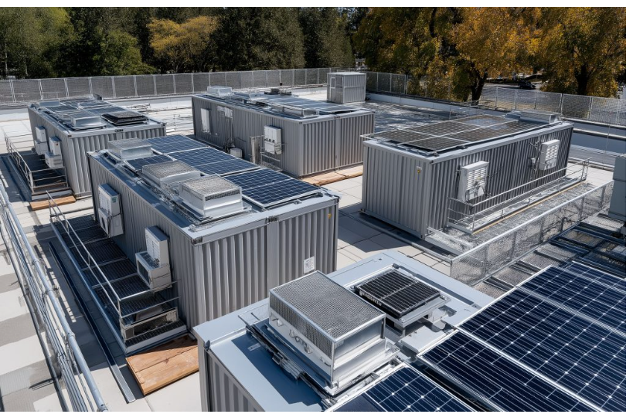
6. Modular Data Center

Slide 41
Difference between Traditional and Modular Data Center
Aspect | Traditional DC | Modular DC
Deployment Time | Long (years) | Weeks to months
Upfront Cost | High | Lower and incremental
Scalability | Requires major construction | Add modules as needed
Flexibility | Rigid | Highly adaptable
Mobility | Fixed | Can be relocated
Energy efficiency & cooling | Cooling systems are designed for peak load, often leading to overcooling and higher energy consumption. Retrofitting new cooling technologies is difficult and expensive. | Cooling is optimized per module, closely matching IT load. Easier adoption of modern cooling techniques results in better energy efficiency

Slide 42
7. Changes to improve traditional 3 tier Data Center Architecture- from looped switched technologies to Spanning Tree

Slide 43
LAN with no redundant links

Slide 44
Problem 1- Ethernet loops (Broadcast storms)

Slide 45
Problem 1- Ethernet loops (Broadcast storms)
This happens when a BUM (broadcast, unknown-unicast, and multicast) frame loops around the switches indefinitely. A broadcast storm keeps going until a link is oversaturated and fails or a switch crashes because of a high CPU usage.

Slide 46
Ethernet loops (Broadcast storms)
SW1 receives a broadcast frame on the link SW1-SW2, it sends a copy out all its ports (to SW3 and to PC1) except the incoming interface (link SW1-SW2);
SW3 gets the broadcast frame and applies the same logic. It sends a copy out all its ports except the one the frame came in.
So it sends the broadcast to SW2 and PC3.
SW2 gets the frame, it sends a copy out all its ports except the incoming link SW3-SW2. So it sends the broadcast to SW1 and PC2.
And the process repeats and goes on indefinitely.

Slide 47
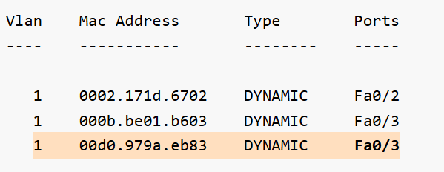
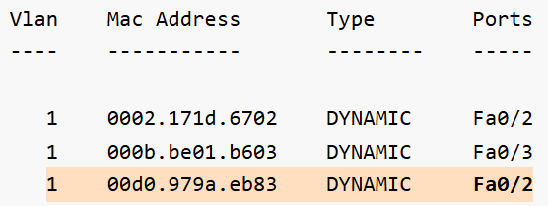
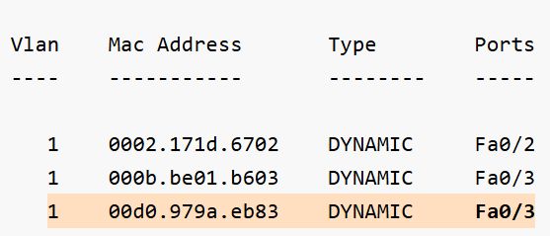
Problem 2- The storm causes another problem called MAC table instability.
When a switch receives a frame, it creates an entry in the MAC address table for the source address and the incoming port. But in case of a broadcast storm, multiple copies of the same frame loop around and the switch receives it on multiple interfaces.

Slide 48
Problem 2- The storm causes another problem called MAC table instability.
When a switch receives a frame, it creates an entry in the MAC address table for the source address and the incoming port. But in case of a broadcast storm, multiple copies of the same frame loop around and the switch receives it on multiple interfaces.

Slide 49
Problem 3- End devices receive multiple copies of the same frame.
The last issue that occurs in a case of a loop is that end clients receive multiple copies of the looping frames over and over again while the broadcast storm is active.
As a result, end clients may experience high CPU, and critical applications may starve of resources and fail.

Slide 50
Solution- Spanning Tree Topology
Spanning-Tree prevents loops by breaking the redundant physical topology into a logical loop-free one.
When Spanning-Tree is enabled on a switch (it is by default on all Cisco switches), it controls the state of every switch port and places each one in either a forwarding or a blocking state where:
Ports in forwarding state send and receive frames and act as normal switch interface. In our examples, these ports are shown in green.
Ports in blocking state do not process any frames except for Spanning-Tree messages and do not learn MAC addresses. In the examples, these ports are shown in orange.

Slide 51
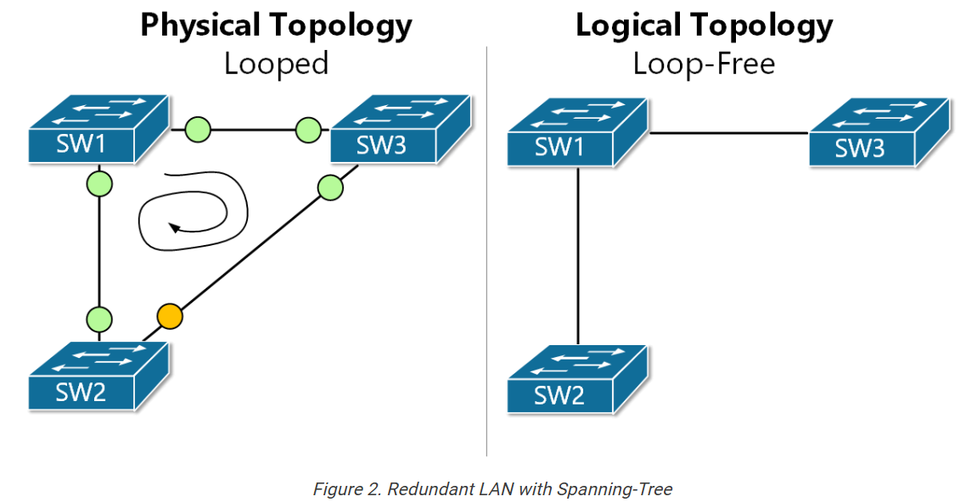
Solution- Spanning Tree Topology

Slide 52
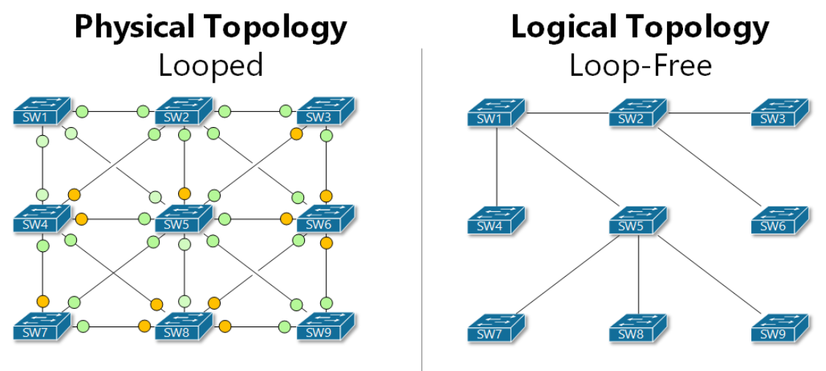
Solution- Spanning Tree Topology

Slide 53
Issues with Spanning Tree Topology
“Spanning Tree solves the loop problem by blocking links, but this leads to poor bandwidth utilization, scalability issues, and slow recovery. To overcome these limitations, modern data centers move away from large Layer-2 domains and adopt multipath topologies such as Fat-Tree and BCube.”

Slide 54
8. Changes to improve traditional 3 tier Data Center Architecture- Leaf Spine Architecture (New Architecture)

Slide 55
Basic DCN (Data Center Network) Architecture- traditional 3-tier data-center network with a shared Layer-2 domain
Server A
Server B
Notes:
CR - like which data center
AR- INside data center, which block or cluster the request should go to
AS and L2 switch, they will check source and destination MAC address
ToR swith- at top of every server

Slide 56
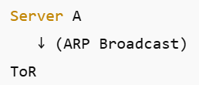
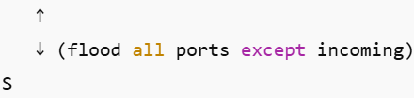


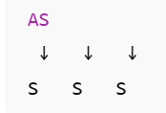
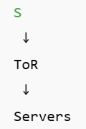
STEP-BY-STEP ARP FLOW (UP & DOWN)

Slide 57
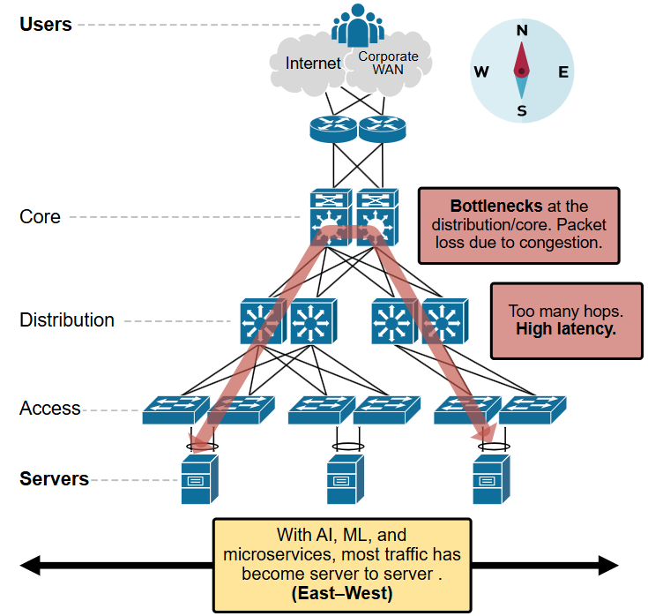

Slide 58
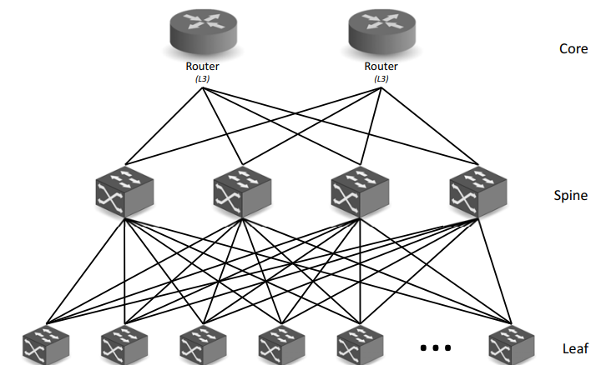
Leaf Spine Architecture
In most leaf–spine designs: The ToR switch is the Leaf switch.
Rack of servers
Rack of servers
Rack of servers
Rack of servers
Rack of servers
Rack of servers
Notes:
CR - like which data center
AR- INside data center, which block or cluster the request should go to
AS and L2 switch, they will check source and destination MAC address
ToR swith- at top of every server

Slide 59
Leaf Spine Architecture
The spine-leaf architecture is also known as a Clos architecture (named after Charles Clos, a researcher at Bell Laboratories in the 1950s) where every leaf switch is connected to each of the spine switch in a full-mesh topology.
The spine-leaf mesh can be implemented using either Layer 2 or 3 technologies (routers and switches) depending on the capabilities available in the networking switches.
Redundant connections to each spine minimizes the risk of overloading the links on the spine-leaf fabric
Notes:
CR - like which data center
AR- INside data center, which block or cluster the request should go to
AS and L2 switch, they will check source and destination MAC address
ToR swith- at top of every server

Slide 60
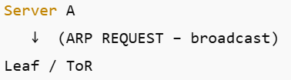
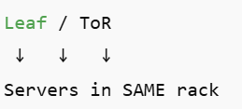

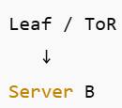
What if destination server is in another rack?
STEP-BY-STEP Traffic Flow
In a modern leaf–spine architecture, a leaf switch behaves like a router when communicating with the spine, and forwarding decisions are based on IP addresses rather than MAC flooding.

Slide 61
Leaf Spine Architecture Advantages
The spine-leaf architecture is optimized for east-west traffic that is required by most software defined solutions. The advantages of this approach are:
All interconnections are used and there is no need for STP to block loops
All east-west traffic is equidistant so traffic flow has deterministic latency
Switch configuration is fixed so that no network changes are required for a dynamic server environment
Notes:
Vm to Vm in same rack - only 1 hop (only leaf)
Vm (one rack) to other Vm (other rack) - (leaf - spine - leaf) 3 hops

Slide 62
Leaf Spine Architecture Disadvantages
Amount of cables and network equipment required to scale the bandwidth since each leaf must be connected to every spine device.
Limited spine ports can lead to limited switch connections - further can limit no. of hosts
Oversubscription situation needs to be checked-
Example- Leaf has 10 servers × 10 Gbps = 100 Gbps
Leaf uplinks to spine = 20 Gbps
Oversubscription = 100 : 20 = 5 : 1
Notes:
In a 5:1 oversubscribed leaf, the aggregate server bandwidth is five times greater than the uplink capacity, meaning that if multiple servers transmit simultaneously at line rate, they must share the uplink bandwidth.”
At full load, five times more server bandwidth exists than uplink capacity.

Slide 63
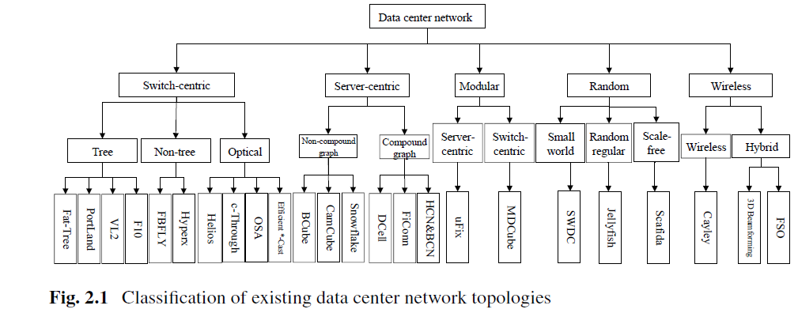
8. Network Topologies of Data Center

Slide 64
9. FAT TREE TOPOLOGY

Slide 65
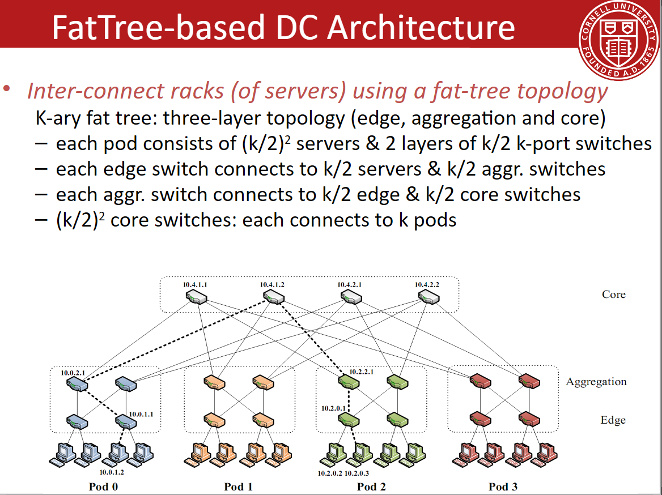
Notes:
Value of k must be even

Slide 66
QUICK SUMMARY

Slide 67
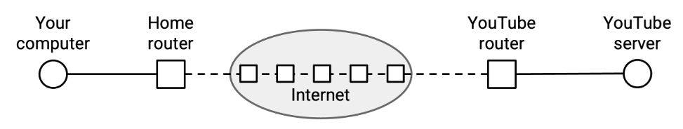
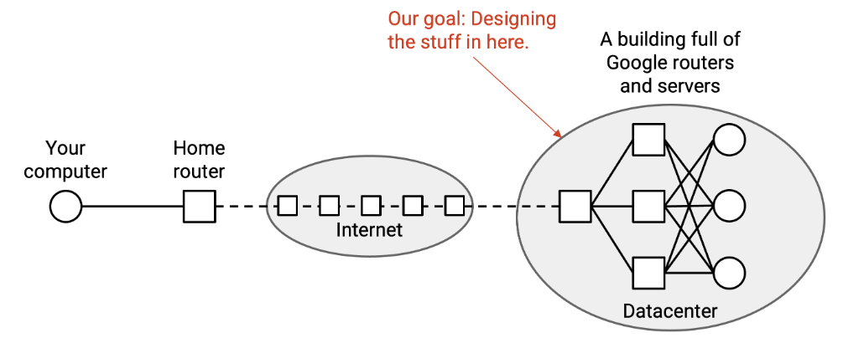

Slide 68
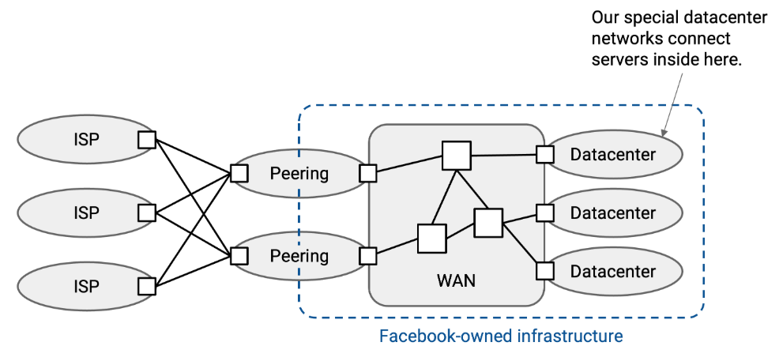
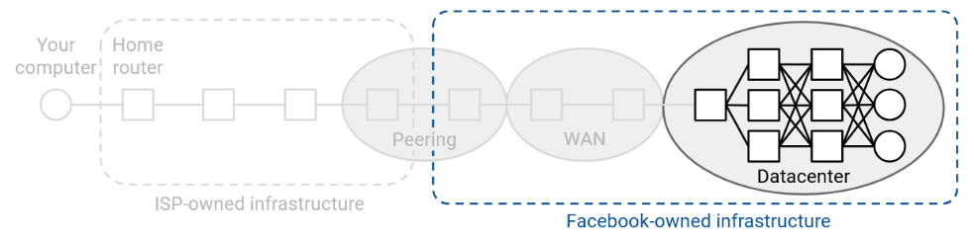
Notes:
Peering - Peering is an agreement where two networks of equal standing connect directly to exchange traffic for their mutual benefit.

Slide 69
Data Center Specifications
The datacenter network is run by a single organization
Custom hardware or software can be implemented
Datacenters are homogeneous, where every server and switch is built and operated exactly the same.
some computers might be newer than others, but in a datacenter, every computer is usually part of the same generation, and the entire datacenter is upgraded at the same time.
datacenter network exists in a single physical location, so organization doesn’t have to think about long-distance links like undersea cables. Within that single location, organization has to support extremely high bandwidth.
Notes:
In a 5:1 oversubscribed leaf, the aggregate server bandwidth is five times greater than the uplink capacity, meaning that if multiple servers transmit simultaneously at line rate, they must share the uplink bandwidth.”
At full load, five times more server bandwidth exists than uplink capacity.

Slide 70
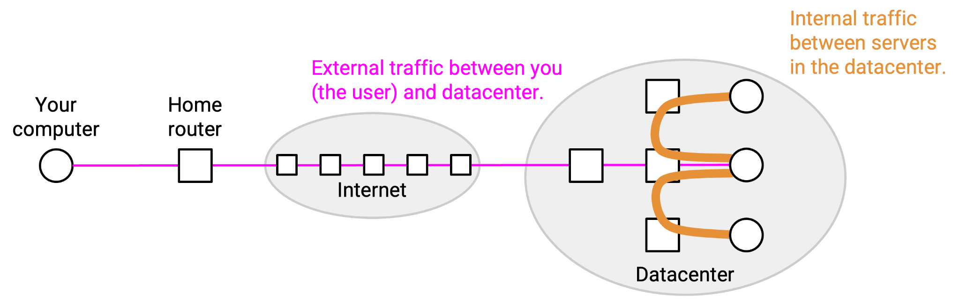
Request from end user for a web page- How packet will be routed
If you requested a Facebook feed, different servers might need to work together to combine ads, photos, posts, etc. It wouldn’t be practical if every server had to know everything about Facebook to process your request by itself.
Notes:
In a 5:1 oversubscribed leaf, the aggregate server bandwidth is five times greater than the uplink capacity, meaning that if multiple servers transmit simultaneously at line rate, they must share the uplink bandwidth.”
At full load, five times more server bandwidth exists than uplink capacity.

Slide 71
Request from end user for a web page- How packet will be routed
In order for the different servers to coordinate, the first server triggers many backend requests to collect all the information needed in your request.
A single user request could trigger hundreds of backend requests (521 on average, per a 2013 Facebook paper) before the response can be sent back to the user.
In general, there’s significantly more backend traffic between servers, and the external traffic with the user is very small in comparison.
Notes:
In a 5:1 oversubscribed leaf, the aggregate server bandwidth is five times greater than the uplink capacity, meaning that if multiple servers transmit simultaneously at line rate, they must share the uplink bandwidth.”
At full load, five times more server bandwidth exists than uplink capacity.

Slide 72
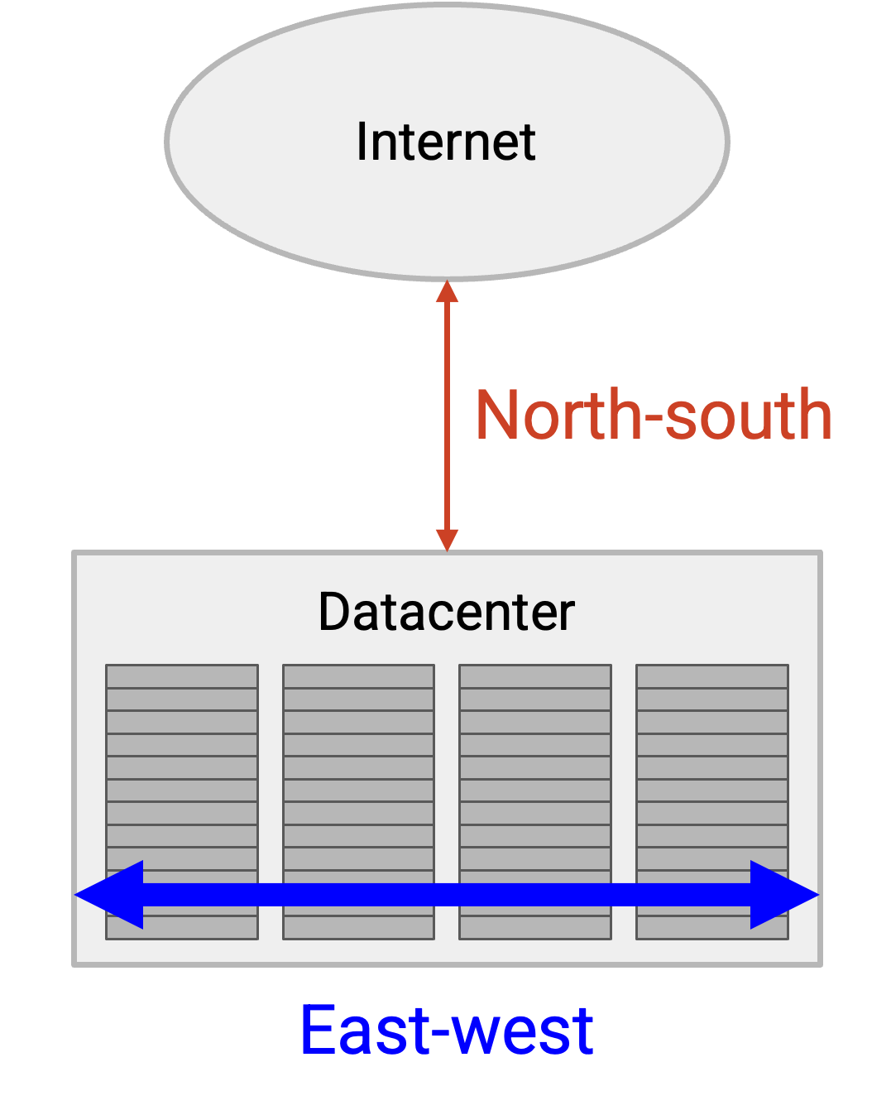
Traffic Flow
Notes:
In a 5:1 oversubscribed leaf, the aggregate server bandwidth is five times greater than the uplink capacity, meaning that if multiple servers transmit simultaneously at line rate, they must share the uplink bandwidth.”
At full load, five times more server bandwidth exists than uplink capacity.

Slide 73
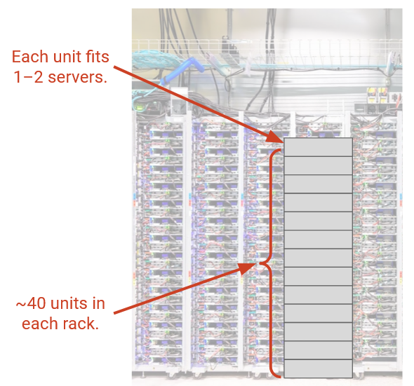
Racks
Notes:
In a 5:1 oversubscribed leaf, the aggregate server bandwidth is five times greater than the uplink capacity, meaning that if multiple servers transmit simultaneously at line rate, they must share the uplink bandwidth.”
At full load, five times more server bandwidth exists than uplink capacity.

Slide 74
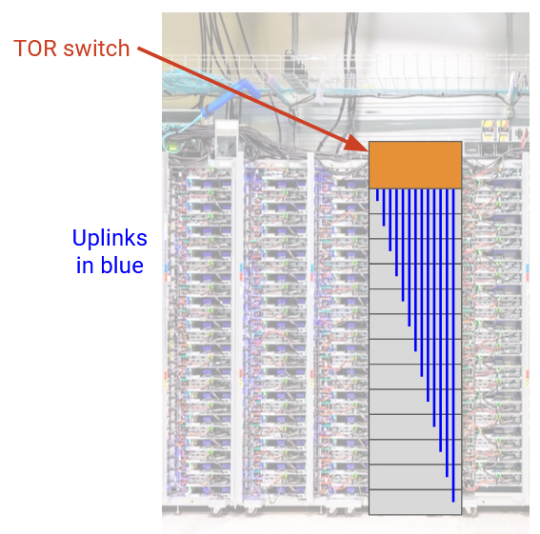
Racks
Notes:
In a 5:1 oversubscribed leaf, the aggregate server bandwidth is five times greater than the uplink capacity, meaning that if multiple servers transmit simultaneously at line rate, they must share the uplink bandwidth.”
At full load, five times more server bandwidth exists than uplink capacity.

Slide 75
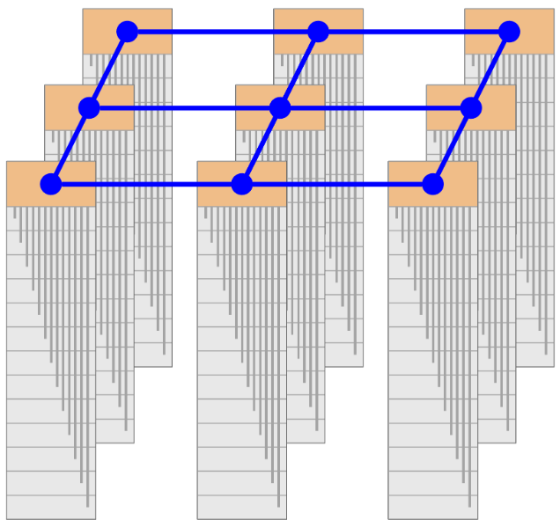
Communication between Racks
Notes:
In a 5:1 oversubscribed leaf, the aggregate server bandwidth is five times greater than the uplink capacity, meaning that if multiple servers transmit simultaneously at line rate, they must share the uplink bandwidth.”
At full load, five times more server bandwidth exists than uplink capacity.

Slide 76
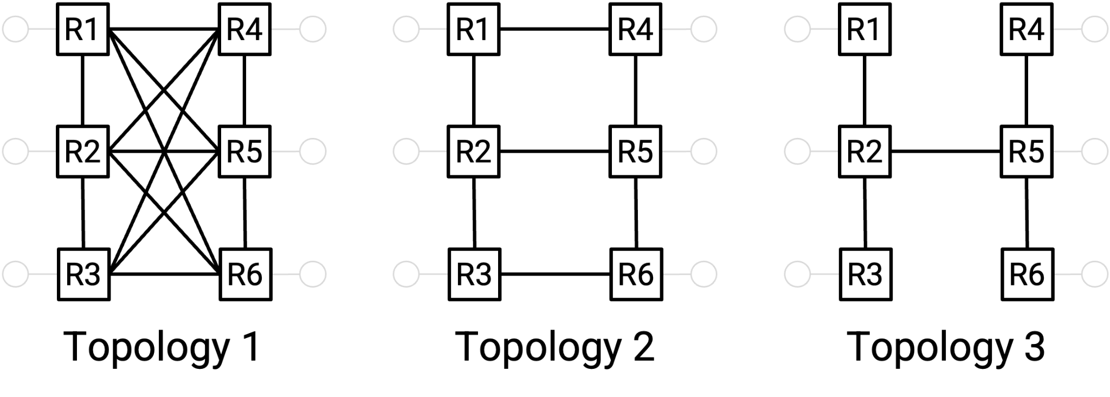
Possible Network Connections
Left network is more connected: We have to cut more links to disconnect the network. This indicates that there are lots of redundant links, which allows us to run many simultaneous high-bandwidth connections.
Right network is less connected is to say: We only have to usr the 2-5 link to connect the network, which indicates the existence of a bottleneck that prevents simultaneous high-bandwidth connections.
Notes:
THIS I ABOUT FAILURE

Slide 77
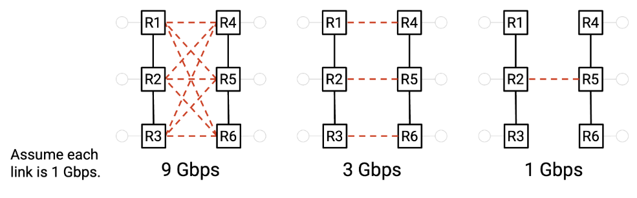
Bisection Bandwidth
Way to quantify how connected a network is.
To compute bisection bandwidth, we compute the number of links we need to remove in order to partition the network into two disconnected halves of equal size.
The bisection bandwidth is the sum of the bandwidths on the links that we cut.
The most-connected network has full bisection bandwidth.
Notes:
THIS IS ABOUT PERFROMANCE UNDER LOAD

Slide 78
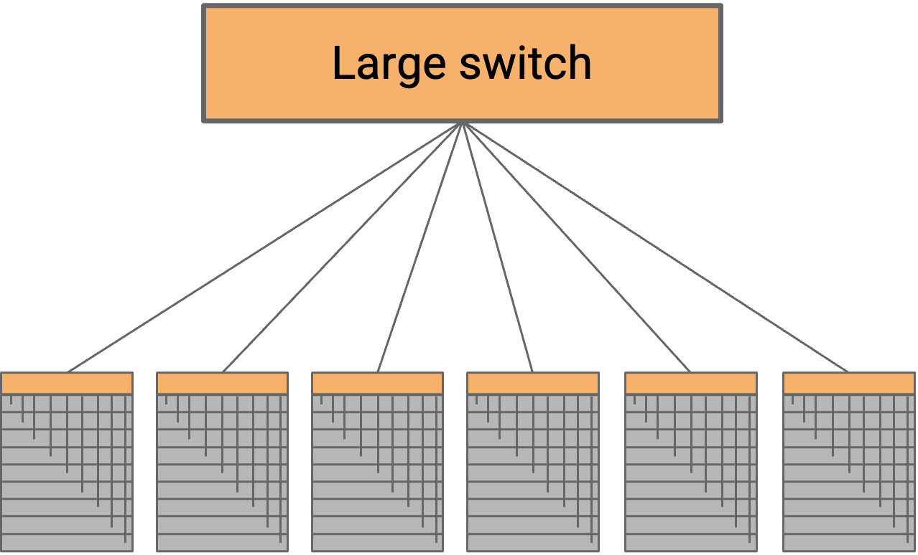
Data Center Topologies
One physical port for every rack (potentially up to 2500 ports).
number of external ports - radix of the switch
switch would need to have enormous capacity (potentially petabits per second) to support all the racks.
This switch is impractical to build
Notes:
In a 5:1 oversubscribed leaf, the aggregate server bandwidth is five times greater than the uplink capacity, meaning that if multiple servers transmit simultaneously at line rate, they must share the uplink bandwidth.”
At full load, five times more server bandwidth exists than uplink capacity.

Slide 79
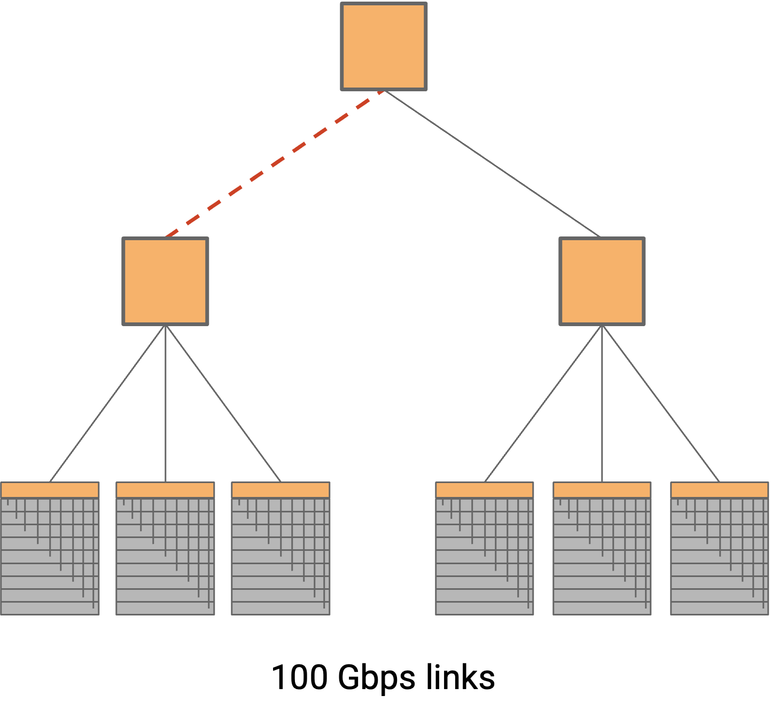
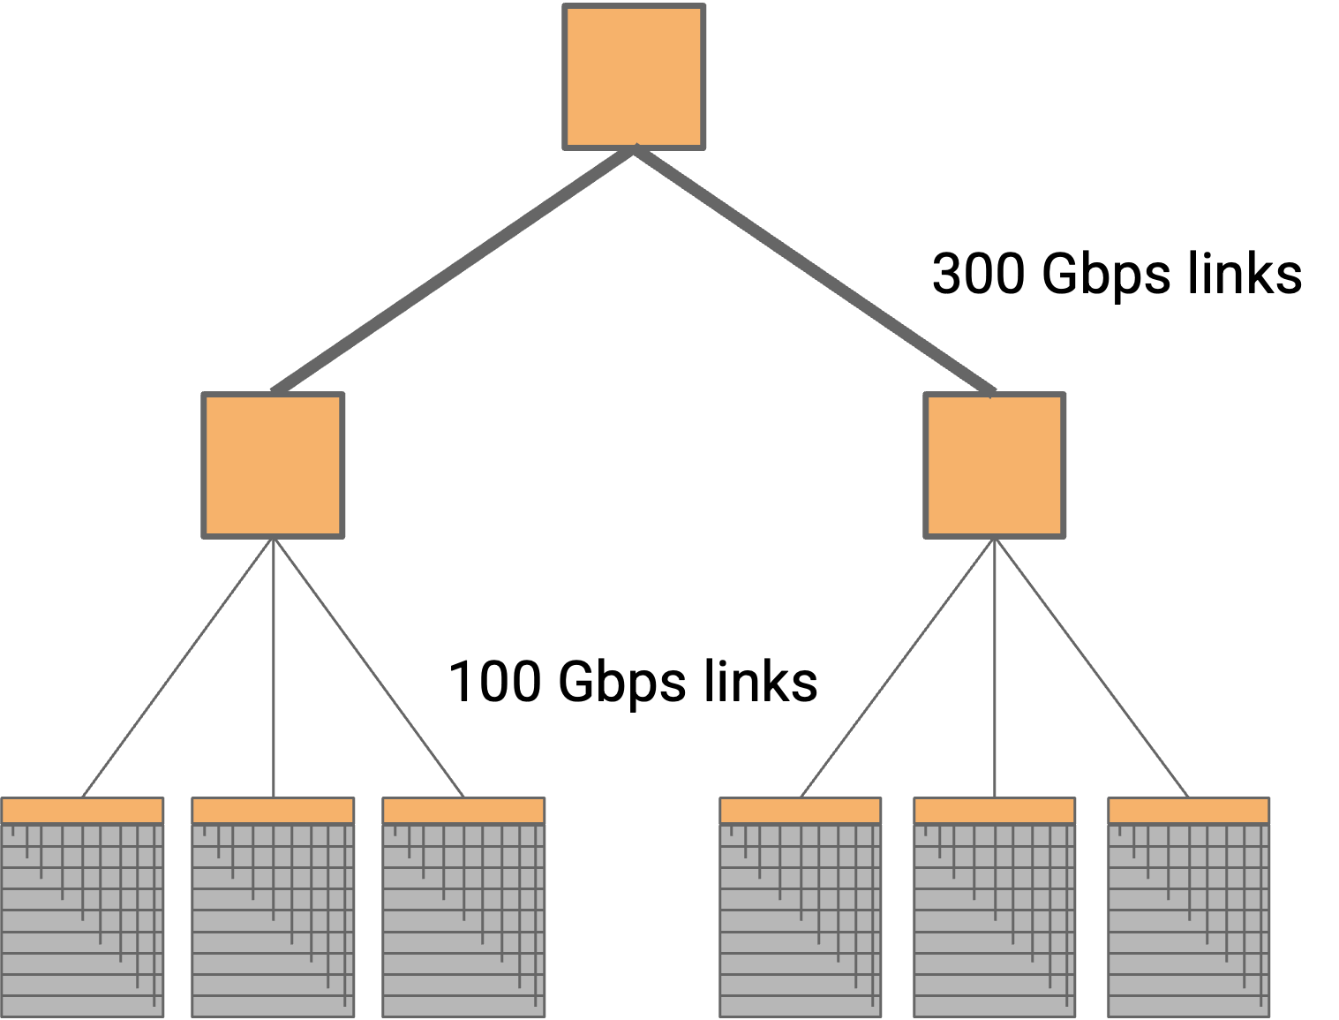
Data Center Topologies
The bisection bandwidth is lower. A single link is the bottleneck between the two halves of the tree.
four lower links are 100 Gbps, and the two higher links are 300 Gbps, then we’ve removed the bottleneck and restored full bisection bandwidth.
Notes:
In a 5:1 oversubscribed leaf, the aggregate server bandwidth is five times greater than the uplink capacity, meaning that if multiple servers transmit simultaneously at line rate, they must share the uplink bandwidth.”
At full load, five times more server bandwidth exists than uplink capacity.

Slide 80
Data Center Topologies Issues
Custom-built switches- high bandwidth or radix. These switches are still expensive to build.
design a topology that gives high bisection bandwidth, using cheap commodity elements?
Use a large number of cheap off-the-shelf switches, where all the switches have the same number of ports, each switch has a low number of ports, and all link speeds are the same.
Notes:
In a 5:1 oversubscribed leaf, the aggregate server bandwidth is five times greater than the uplink capacity, meaning that if multiple servers transmit simultaneously at line rate, they must share the uplink bandwidth.”
At full load, five times more server bandwidth exists than uplink capacity.

Slide 81
Clos Networks
In a classic Clos network, all the racks on the left send data to the racks on the right.
In datacenters, racks can both send and receive data, so instead of having a separate layer of senders and recipients, we can have a single layer with all the racks (acting as either sender or recipient).
Then, data travels along one of the many paths deeper into the network, and then back out to reach the recipient. This result is called a folded Clos network, because we’ve “folded” the sender and recipient layers into one.
Notes:
In a 5:1 oversubscribed leaf, the aggregate server bandwidth is five times greater than the uplink capacity, meaning that if multiple servers transmit simultaneously at line rate, they must share the uplink bandwidth.”
At full load, five times more server bandwidth exists than uplink capacity.

Slide 82
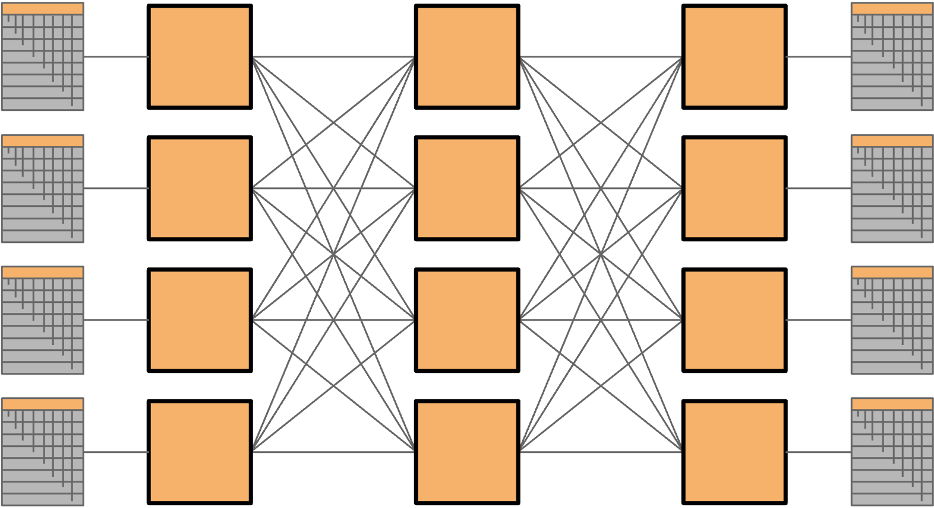
Clos Networks
Notes:
In a 5:1 oversubscribed leaf, the aggregate server bandwidth is five times greater than the uplink capacity, meaning that if multiple servers transmit simultaneously at line rate, they must share the uplink bandwidth.”
At full load, five times more server bandwidth exists than uplink capacity.

Slide 83
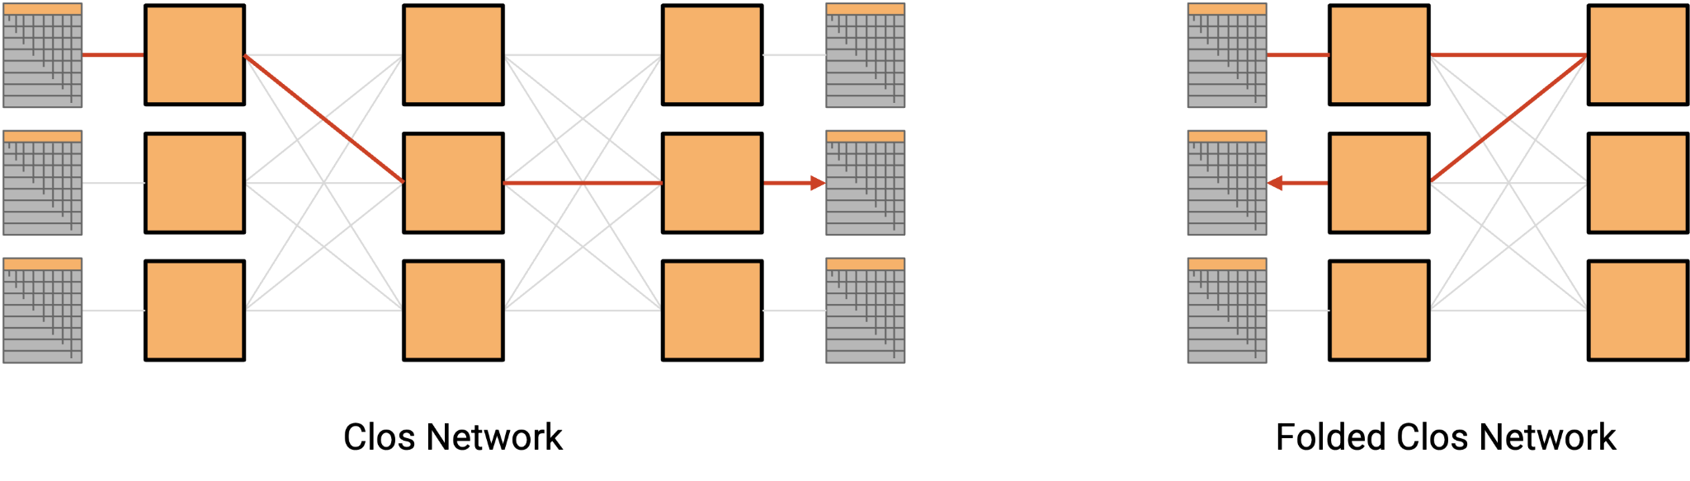
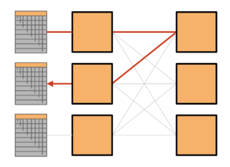
Clos Networks
Notes:
In a 5:1 oversubscribed leaf, the aggregate server bandwidth is five times greater than the uplink capacity, meaning that if multiple servers transmit simultaneously at line rate, they must share the uplink bandwidth.”
At full load, five times more server bandwidth exists than uplink capacity.

Slide 84
Fat-Tree Clos Topology
In a classic Clos network, all the racks on the left send data to the racks on the right.
In datacenters, racks can both send and receive data, so instead of having a separate layer of senders and recipients, we can have a single layer with all the racks (acting as either sender or recipient).
Then, data travels along one of the many paths deeper into the network, and then back out to reach the recipient. This result is called a folded Clos network, because we’ve “folded” the sender and recipient layers into one.
Notes:
In a 5:1 oversubscribed leaf, the aggregate server bandwidth is five times greater than the uplink capacity, meaning that if multiple servers transmit simultaneously at line rate, they must share the uplink bandwidth.”
At full load, five times more server bandwidth exists than uplink capacity.

Slide 85
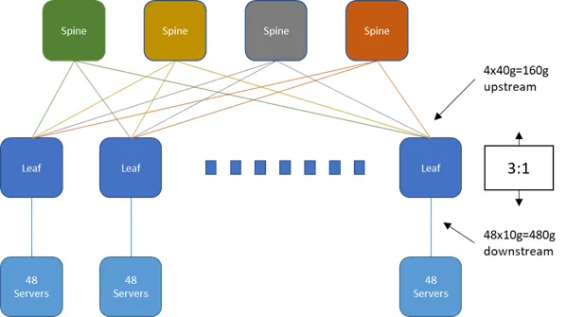
Oversubscription Ratio
Imagine a Leaf switch with 48x10g ports for attaching endpoints giving 480Gb/s of port capacity. If this Leaf is connected to 4 spine switches at 40Gb/s it will have a total uplink capacity of 160Gb/s.
So the oversubscription ratio is: 480:160 and dividing both sides by 160 we get 3:1.
Notes:
In a 5:1 oversubscribed leaf, the aggregate server bandwidth is five times greater than the uplink capacity, meaning that if multiple servers transmit simultaneously at line rate, they must share the uplink bandwidth.”
At full load, five times more server bandwidth exists than uplink capacity.

Slide 86
Oversubscription Ratio
Notes:
In a 5:1 oversubscribed leaf, the aggregate server bandwidth is five times greater than the uplink capacity, meaning that if multiple servers transmit simultaneously at line rate, they must share the uplink bandwidth.”
At full load, five times more server bandwidth exists than uplink capacity.

